Slide 1
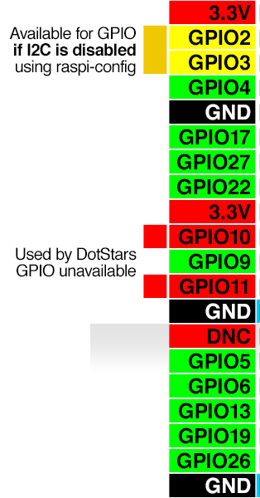
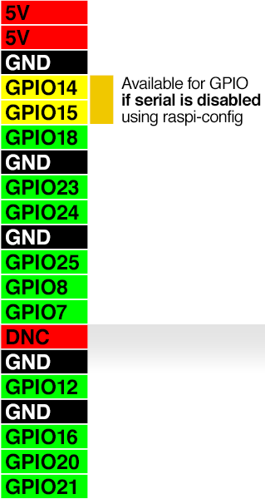
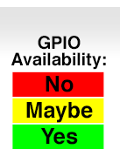
1
3
5
7
9
11
13
15
17
19
21
23
25
2
4
6
8
10
12
14
16
18
20
22
24
26
I2C
SDA (Serial Data line)
SCL (Serial Clock Line)
UART TXD
UART RXD
LED
MOSI (Master Out-Slave In)
MOSI (Master In Slave Out)
SCLK (System clock)
SPI0_CE0_Negative
SPI0_CE1_Negative
2729
31
33
35
37
39
2830
32
34
36
38
40

Slide 2
rasp-config

